Slide 1

Lunch and Learn for people who develop websites good and want to make emails good too

Slide 2
Table of contents
01
02
03
04
05
06
//
03
//
07
//
13
//
15
//
16
//
18
Pre-Development
Tables are taboo!
Click here…
if you can!
Paragraphs: A negative outlook
Nobody likes division anyway
Ul need an alternative
07
08
09
10
11
//
19
//
23
//
24
//
27
//
28
These have been marginalized
What’s in a name?
Back in fashion
Looking Forward
Your questions… answered!

Slide 3



What to watch for
01
Pre-Development
Background
images
And
Gradients
Text
Inside
images
Non-standard fonts
+ 1 More Thing
Question: are you deploying the email?
If so, how?

Slide 4
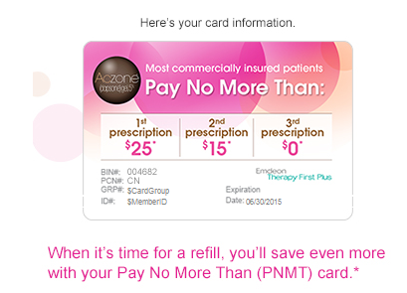
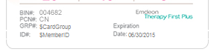
Text Inside Images
01
Pre-Development
Can be done if designed properly
If there isn’t enough room for the text, the image will either be stretched or broken

Slide 5
Non-standard Fonts
01
Pre-Development
There is no way to incorporate web fonts in emails
To ensure a consistent experience, all text must use web-safe fonts
Web-Safe Font Stacks
Sans-serif
Monospace
serif
Helvetica
Arial
Sans-serif
Georgia
Utopia
Charter
Serif
Verdana
Geneva
Sans-serif
Courier New
Courier
Monospace
Times New Roman
Times
Serif

Slide 6

Background Images and Gradients
01
Pre-Development
Background images are not universally supported and are hard to implement
Gradients are too new for most email clients to support (no CSS3)
Sorry!
We need to remove this background image because Outlook doesn’t like nice things.

Slide 7
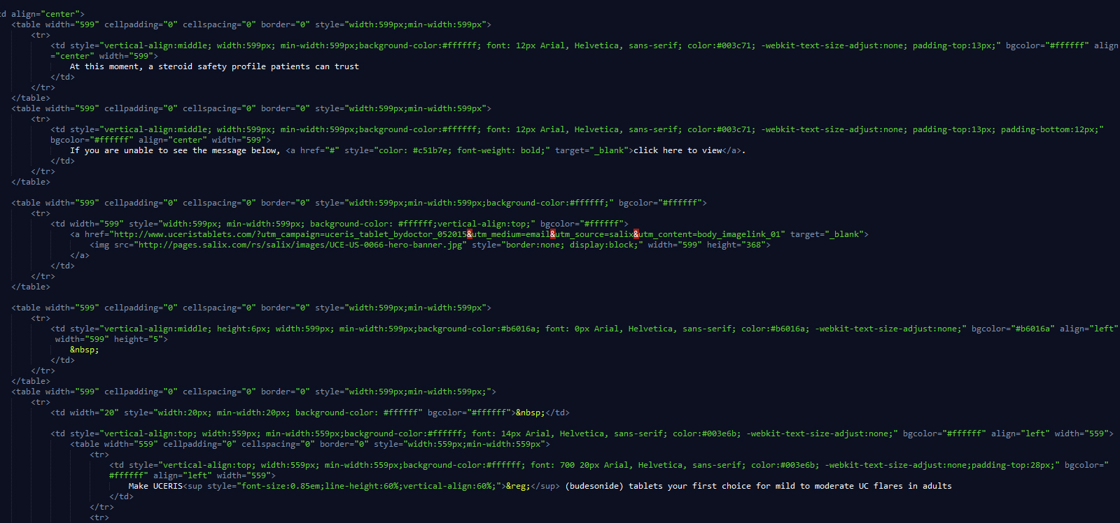
Tables are Taboo!
02

Slide 8
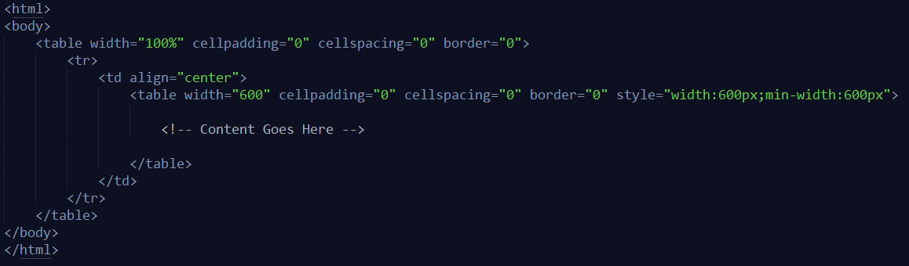
Building The layout
02
Tables are taboo!
Tables should be used for the entire structure of the email
Nesting tables is the key to proper positioning of your text and images
This is all we need to get started. The outer table is used to ensure our email is centered, and the inner table will contain our content. No doctype, no head, and no styles!

Slide 9

Google stole my styles!
Stylesheets and style tags are not supported by all email clients. If we want to style our content, we need to inline our css.
Kickin’ it old school!

Slide 10
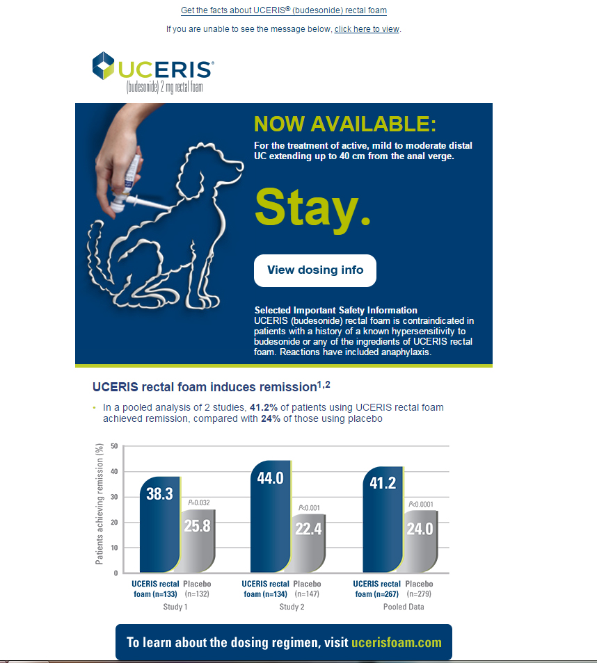
Example Email
02
Tables are taboo!
Styled
content
Nested Tables
Buttons
List items

Slide 11
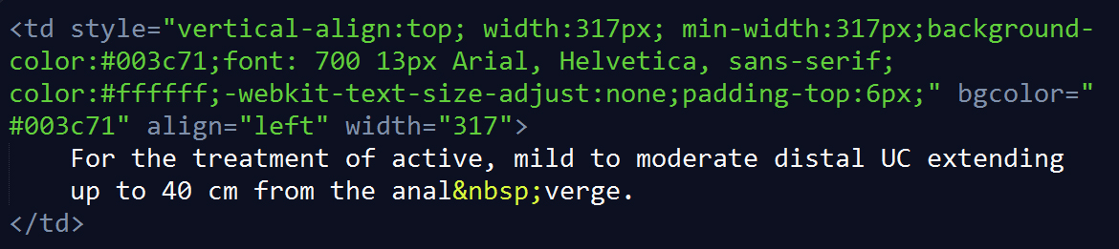
Styled content
02
Tables are taboo!
Where should I put my styles?
Tables and table cells are 100% supported by all email clients
Your table cells are going to contain all of your content anyway
Why risk creating bugs by adding additional tags, when you can just style your table cells?
“The simplest solution is often the best solution”
– Gandalf the Grey

Slide 12
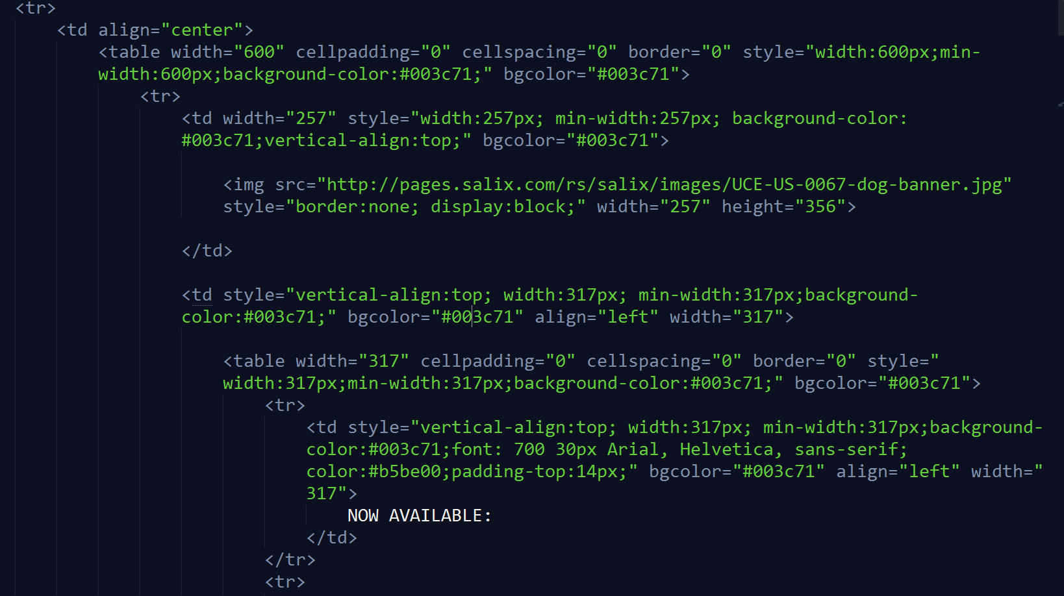
Nested Tables
02
Table 1
Tables are taboo!
Table 2

Slide 13
The button problem
03
Click here…if you can!
Users expect they can click anywhere on a button
We usually do this with CSS by padding the container to create a clickable area around the text
There are issues with creating these padded containers in emails
The best (and suggested) way to make a button is to just use an image
Click Me

Slide 14
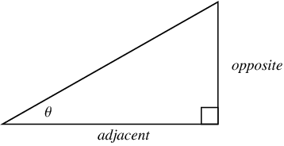
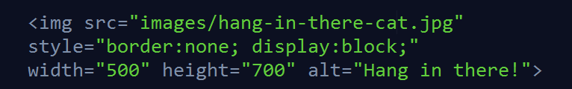
The big picture
Images are simple, there are only a few things you need:
Width (even) and Height
Display: block
Border: none
Alt text?

Slide 15
<p> stands for problems
04
Paragraphs: A Negative outlook
Gmail
Has had issues with paragraph formatting in the past
Yahoo! Mail
Paragraphs have no bottom spacing by default
Paragraph support is a mess!
Outlook.com
Has pre-set margins and line-heights that cannot be adjusted
Outlook 2007/2010
Ignore padding in paragraphs

Slide 16
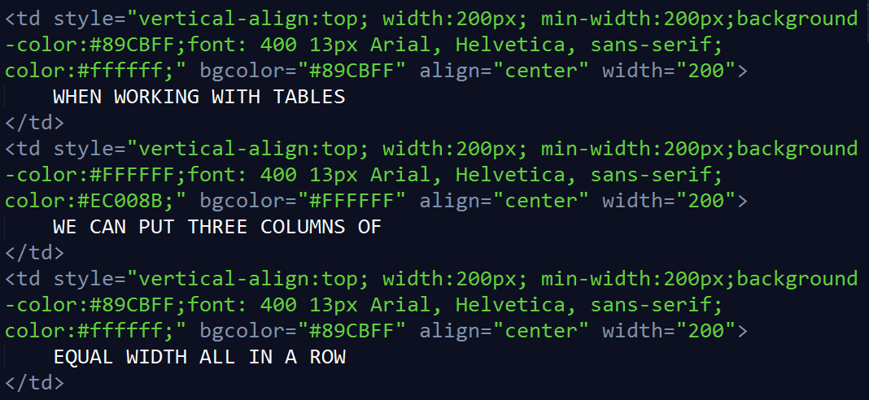
<div> likes to be difficult
V
05
Nobody likes division anyway
When working with tables
We can put three columns Of
Equal width all in a row

Slide 17
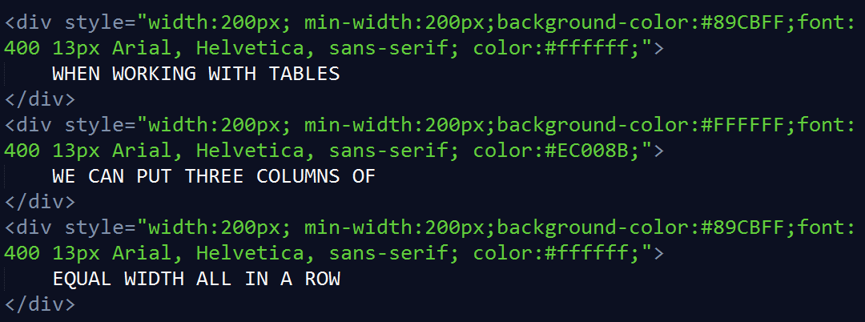
<div> likes to be difficult
V
05
Nobody likes division anyway
Div’s don’t like to play nice
No matter what width you set for them
Many email clients will still use 100% width
This width gets ignored!

Slide 18
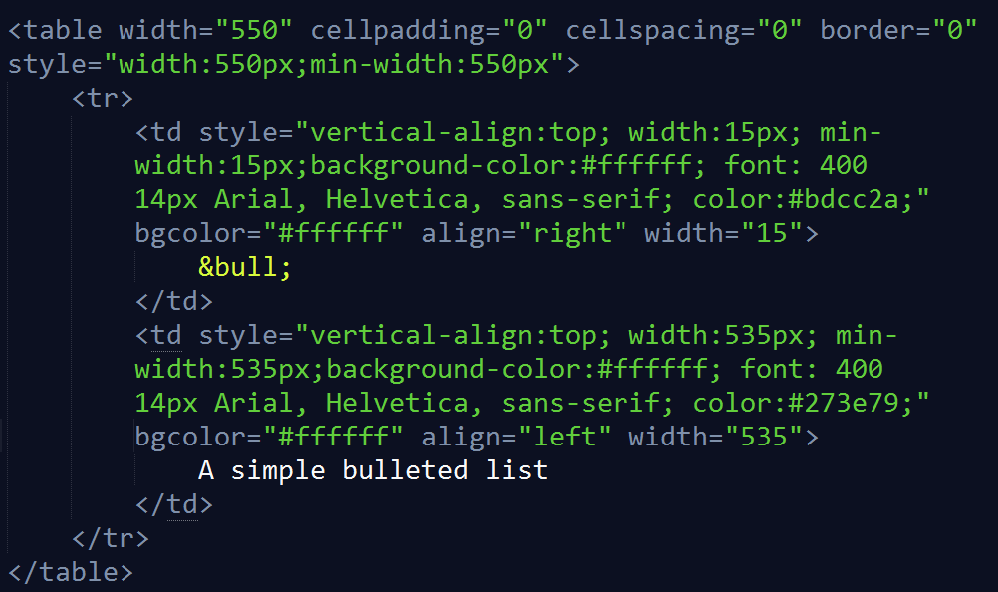
Look out for list items
06
UL Need an alternative
OutLook for list items
By using tables, we avoid any need to use complicated list styles, which aren’t properly supported. And we can use anything we want for our bullets. Win-win!
“Certain” clients have limited support for list items (UL, OL, LI)
They will render your lists as paragraphs and spans and ignore CSS list styles

Slide 19
Why Margins don’t work
07
These have been marginalized
Support issues for margins go beyond just paragraphs
Outlook.com has no support for margins of any kind
Email spacing options
Spacer Images
Spacer Cells
Padding
- Use 1px transparent images to fill empty space
- Stretch the image to the size you need inside a table cell
- If images are disabled, client sees a lot of broken image icons
- Use table cells with a set height and width to fill empty space
- Must have content in the cell or some email clients will ignore it altogether (use &nbsp; as content)
- Apply padding to our table cells in place of margins
- Only issue with support is on paragraphs, which we aren’t using
- Emails use box styling, so padding is added to the width. Must remember to account for extra size

Slide 20
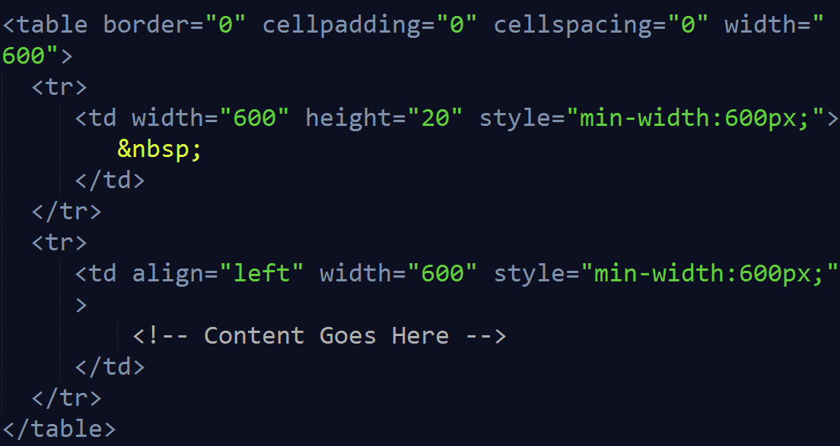
07
Vertical

Slide 21
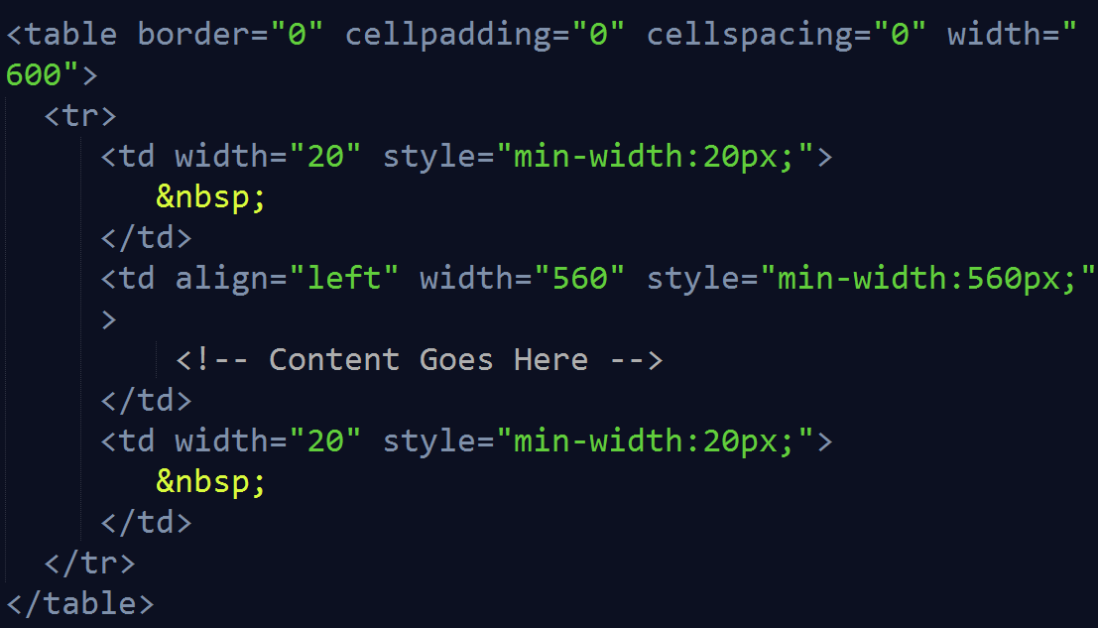
07
Horizontal

Slide 22
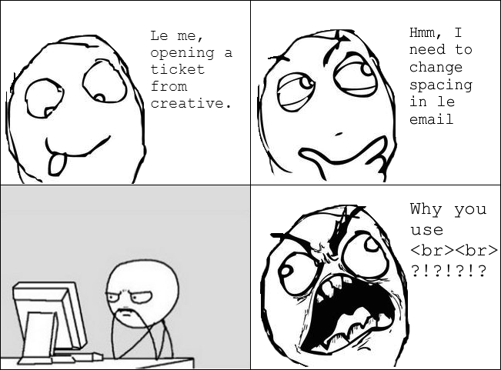
One last Spacing thing…
07

Slide 23
<A> problem with no solution
08
What’s in a name?
Internal Links
Linking to anchors within a page should work, in theory.
But for some reason a few clients act strangely when a user clicks the link.
Two options:
<a name=“bookmark”>
<a id=“bookmark”>
Neither option is supported universally, with name having slightly better support.
Some developers recommend combining both options:
<a name=“bookmark” id=“bookmark>
List of Issues:
Gmail: The link will do nothing if the area on the page you are linking to is already visible
Outlook 2007: Will move to a spot near the anchor, but usually slightly above or below it
iPhone (iOS8): Anchor links are completely disabled

Slide 24
09
Back in Fashion
Yesterdays Styles, Today!
Inline CSS
No CSS 3
!important
Media Queries
You can choose how you want to do this: write it inline yourself, or use a pre-mailer to inline your css/sass/less file.
Klick has a tool for this!
Many email clients are old and CSS 3 support is limited. Even older CSS has issues
Look online before using a style that may not be supported!
The !important tag breaks styles in Outlook, and it is completely unnecessary.
Generally, our styles are not inherited so we apply them to every element anyway.
They just don’t work, mostly due to Gmail stripping them out.
Pseudo styles such as :hover and :after need to be avoided as well.

Slide 25
09
Back in Fashion
Some styles just clash
Android Doesn’t like your width
How to fix it: min-width
iPhone Doesn’t like your font size
How to fix it: -webkit-text-size-adjust:none;
Outlook Doesn’t like spacing your tables
How to fix it: Make sure your padding is always applied to table cells, not the table itself

Slide 26
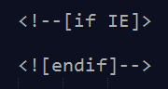
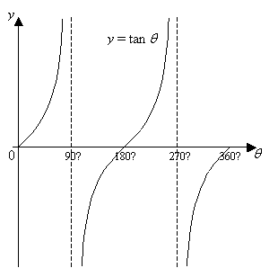
On one condition…
There may be cases where you will need to do this.*
* There aren’t any cases where you will need to do this.

Slide 27

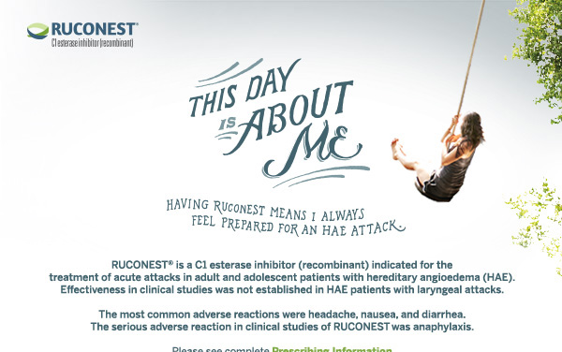
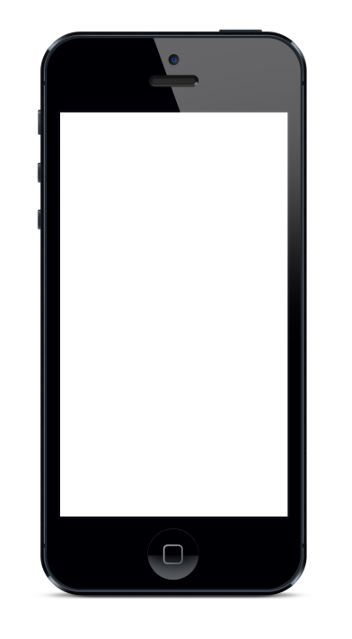
Are emails finally turning a corner?
10
Looking forward

Slide 28
11
Resources
Your Questions…Answered!
Klick Confluence Wiki
Slack and Klick Questions
Klick’s Email Tool
Campaignmonitor.com
Emailonacid.com
Litmus.com
Zurb.com/ink
Questions?
Thank you for coming
Feel free to reach out at any time if you are having issues with emails, or to suggest fixes for obscure bugs I may not have seen yet!
Comments?

